Slide 1
Leave Administration Services

Slide 2
Who is Sedgwick?
Contacting Sedgwick
Roles and Responsibilities
Employee Responsibilities
Employee and Employer Portals
Training Tools – Insightful Videos

Slide 3
Who is Sedgwick?

Slide 4
TOTAL ABSENCE ADMINISTRATION
Who is Sedgwick?
Taking care of people is at the heart of everything we do. Caring counts®
Since our founding in December 1969, Sedgwick has been a purpose-and values-driven company. Our continual growth and evolution has been rooted in our consistent approach to the important work our colleagues perform each day. Our shared purpose has always been - and continues to be - to take care of people.
We aim to simplify the process and reduce complexity, making it easy and effective for everyone involved.

Slide 5
Contacting Sedgwick

Slide 6
TOTAL ABSENCE ADMINISTRATION
Contacting Sedgwick
Employees can contact Sedgwick to:
Request new Leaves of Absence including FMLA, State, ADA, USERRA, and Company Leave of Absences.
Obtain an update on the status of an existing claim or leave of absence.
Report intermittent time off on an existing FMLA leave.
Sedgwick Contact Information:
Phone: 888.436.9530 - Representatives available 24/7.
Employee Portal by logging on to:
https://timeoff.sedgwick.com
Fax: 888.436.9535

Slide 7
Roles and Responsibilities

Slide 8
TOTAL ABSENCE ADMINISTRATION
Roles and Responsibilities
Employee Responsibilities
Employees will be responsible for the following:
Calling Sedgwick to request a new leave of absence as soon as a need to be out of work is necessary but no more than 30 calendar days in advance.
Providing supporting documentation/certification for their leave within 15 calendar days from the date the claim/leave is requested.
Following the employer’s established time off and call-in procedures.
Contacting Sedgwick to report intermittent FMLA time on intermittent leave of absence requests.
If an intermittent leave is not reported within 2 calendar days, the intermittent absence could be denied.

Slide 9
TOTAL ABSENCE ADMINISTRATION
Roles and Responsibilities
Supervisor, Manager and HR Responsibilities
Supervisors, Managers and HR will be responsible for the following:
Referring employees to Sedgwick when the employee indicates a need for a leave of absence.
Consistently communicating policies and procedures.
Reviewing employees time off to ensure any absences reported as FMLA have also been reported and tracked by Sedgwick.
Ensuring employees on an approved leave due to their own serious health condition do not return to work activities until Sedgwick receives the appropriate Return to Work release form.
Responding to Sedgwick email notifications for confirmation of return to work dates or changes in employees absences.

Slide 10
TOTAL ABSENCE ADMINISTRATION
Roles and Responsibilities
What to Expect from Sedgwick
Sedgwick will be responsible for the following:
Handling most leave/claim requests and verifying eligibility
Gathering and reviewing required documentation/certifications
Communicating with the employee, supervisor, manager and HR throughout the entire leave process
Approving, denying and tracking decisions on leaves/claims
Following appropriate adherence to certification guidelines
Appropriately updating state and federal guidelines as they are modified
Notifying the employee and employer when a leave or benefit has exhausted or if the employee is not eligible for the leave/benefit
Coordinating and assisting in the ADAAA review and recommendation process

Slide 11
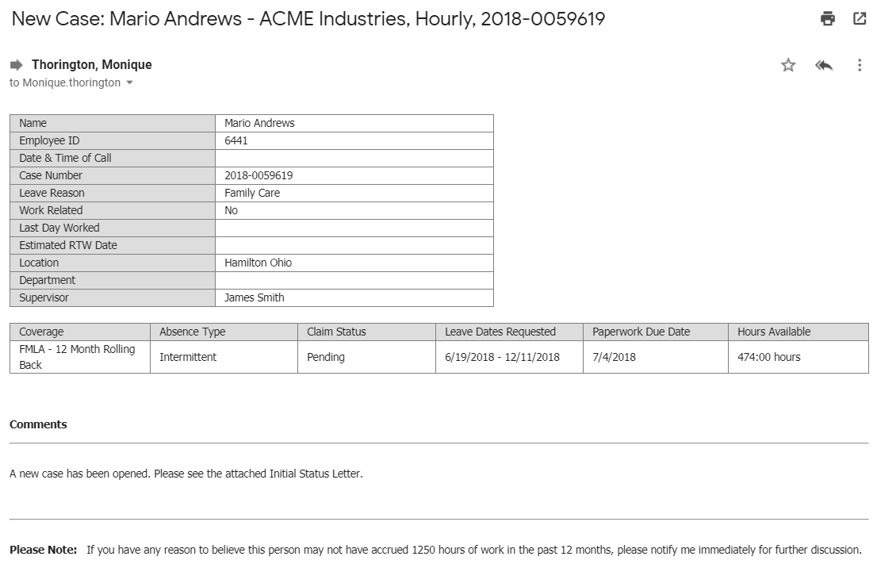
TOTAL ABSENCE ADMINISTRATION
Sample Email Notification
The screenshot to the right shows a sample email notification that direct supervisors will receive when an update to any claim or leave occurs.

Slide 12
Leave Types Sedgwick will be managing for New TSI Holdings, Inc.

Slide 13
TOTAL ABSENCE ADMINISTRATION
Leaves Sedgwick will be managing
Leave Suite
As part of the transition, Sedgwick will be managing the following leave types:
FMLA
State
Unpaid Company
USERRA
ADAAA

Slide 14
Employee Portal

Slide 15
TOTAL ABSENCE ADMINISTRATION
Employee Portals
Employee Portal
The employee portal provides a convenient and secure site for employees to view their leave and absence information. Any time of day or night, they will have quick access to their documents approvals and how much time they have available for their leaves.
Employees can access the site by going to https://timeoff.sedgwick.com to create their secure account. They have access to the following at this site:
Self-Registration
Real time claim status
Viewing all documentation
Utilization calendar
FAQ Support
Interactive messaging with representatives
Display of hours available for all leave types
Track multiple leaves simultaneously
Employee Portal Training Video:
https://sedgwick.visme.co/view/01yw03q6-m3x58k31onwm5krp

Slide 16
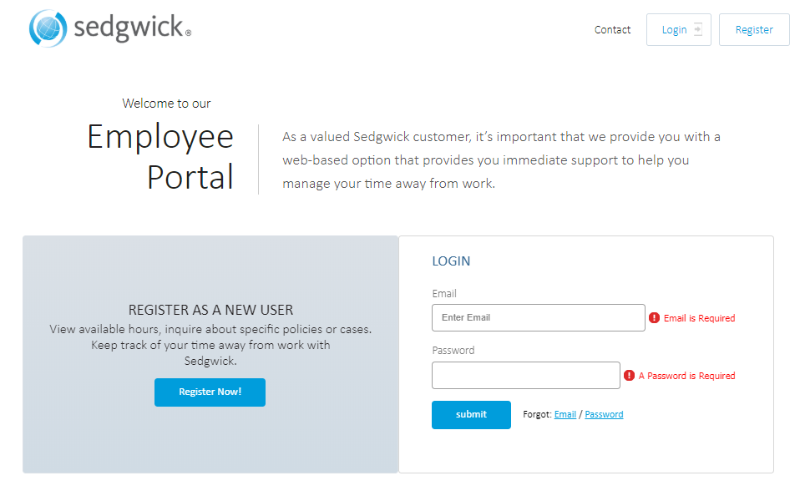
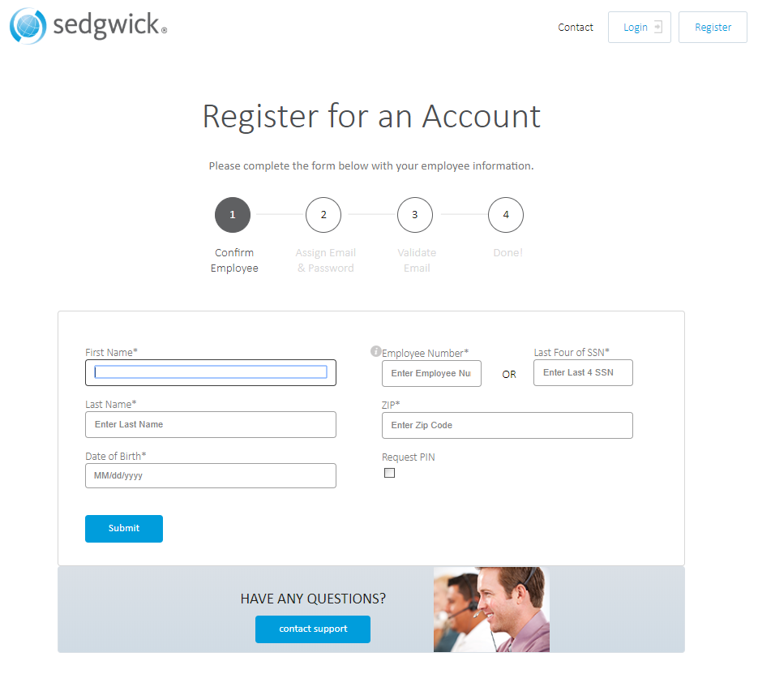
TOTAL ABSENCE ADMINISTRATION
Registering for an account
The screenshot to the right shows the registration screen for the employee portal.
Please remember that if you have elected to send an Employee ID on your eligibility file, your employees cannot register with their SSN, they have to use their Employee ID to register on this site.

Slide 17
Training – Insightful Videos

Slide 18
TOTAL ABSENCE ADMINISTRATION
Training Tools - Intake Video
https://play.vidyard.com/VcXUWNh3FLBG49r5QqSTxx

Slide 19
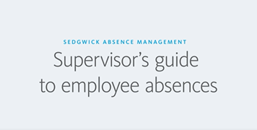
TOTAL ABSENCE ADMINISTRATION
Training Tools - Need to Know Videos
Our Need to Know videos walk you and your employees through the claims process, sharing tips to make sure it goes smoothly. Please click on the Supervisor’s Guide image below to navigate to the video.
https://play.vidyard.com/1mE7m2iboYw5Ccoej16SuH

